Slide 1
面試簡報
面試者：蘇柏丞

Slide 2
01
個人簡介
02
教育性晶片下線經驗
目錄
contents
03
系統晶片設計實驗
04
其他作品

Slide 3

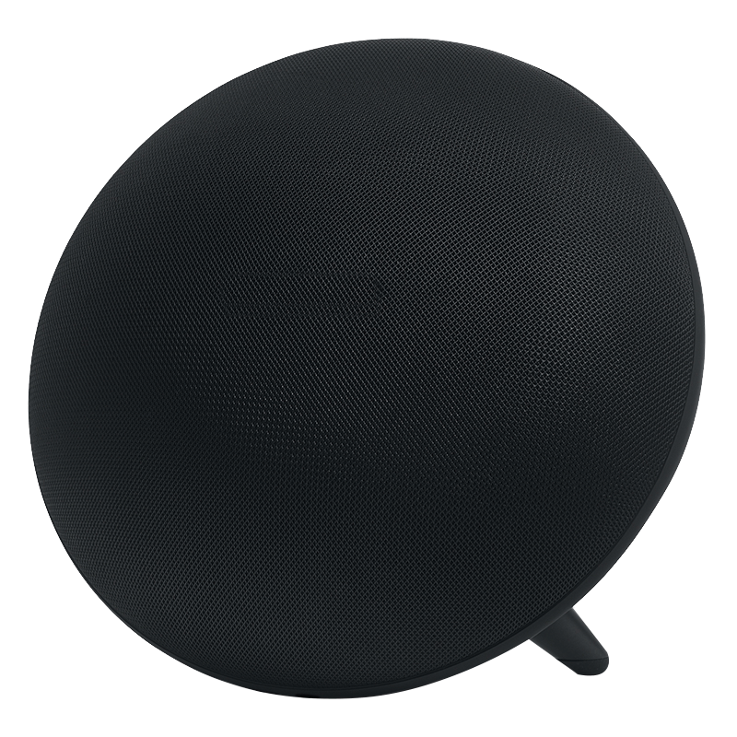
01
個人簡介

Slide 4

個人簡介
姓 名：蘇柏丞
生 日：2001/07/13
信 箱：fossum2523@gmail.com
電 話：0981-933-963
學 歷：臺灣科技大學電子工程學系
指導教授：林銘波教授
實 驗 室：數位積體電路實驗室
相關課程：FPGA系統設計實務(A+)、超大型積體電路設計(A+)、 系統晶片設計實驗(A+)、數位積體電路分析與設計(修習中) 、
高等計算機演算法(修習中) 、 高等數位訊號處理(修習中)
04

Slide 5
專業技能
程式語言
使用工具
英文能力
Verilog
C
Python
Assembly Language
Design Compiler
IC Compiler
Vivado
VCS
Verdi
NC-Verilog
TOEIC 675
05

Slide 6

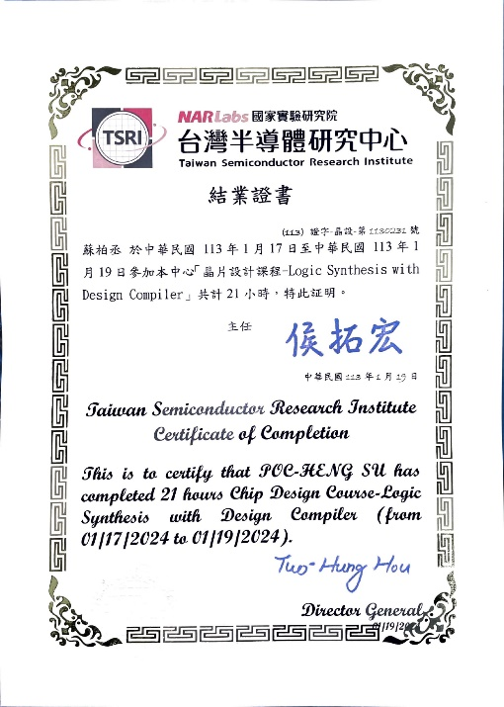
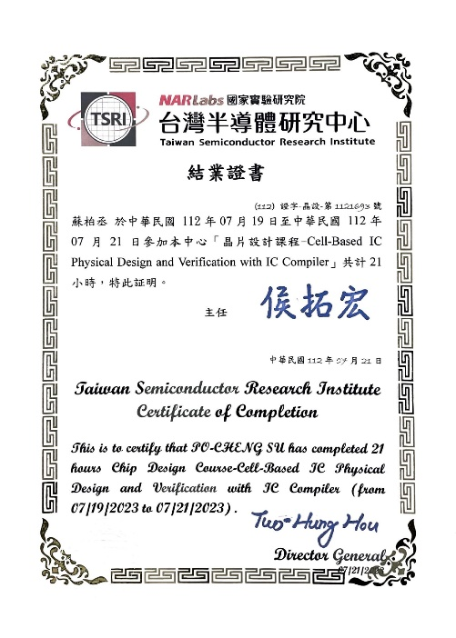
證書
TSRI Cell-Based IC Physical Design and Verification with IC Compiler ( 21 hours )
TSRI Logic Synthesis with Design Compiler ( 21 hours )
06

Slide 7
教育性晶片 下線經驗
02

Slide 8
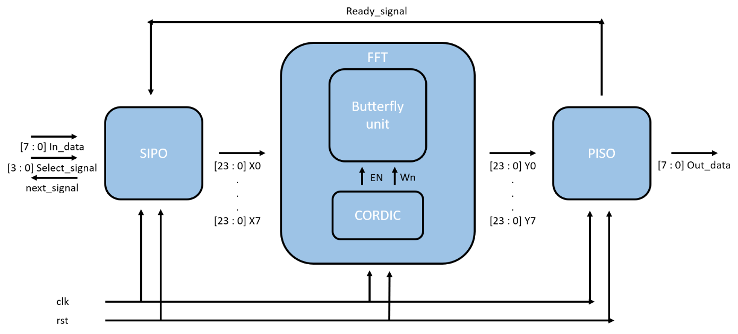
教育性晶片下線經驗-FFT
08

Slide 9
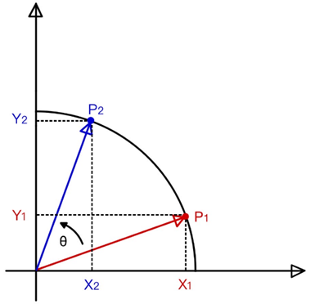
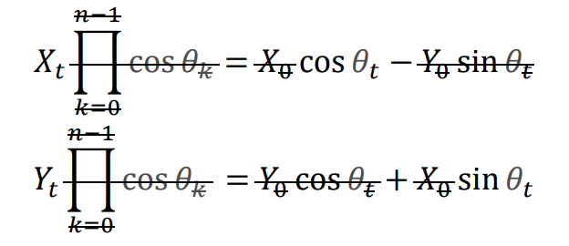
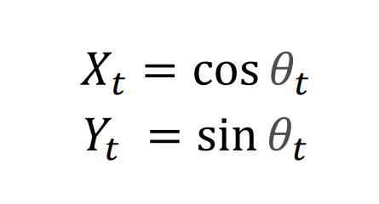
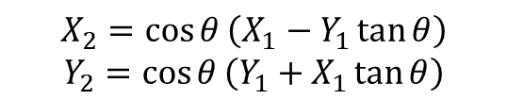
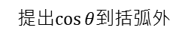
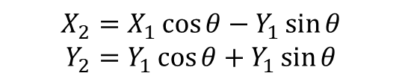
FFT Algorithm - CORDIC
$$X_{2}=X_{1}\cos{θ}−Y_{1}\sin{θ}$$
$$Y_{2}=Y_{1}\cos{θ}+Y_{1}\sin{θ}$$
提出$\cos{θ}$到括弧外
$$X_{2}=\cos{θ}\left(X_{1}−Y_{1}\tan{θ}\right)$$
$$Y_{2}=\cos{θ}\left(Y_{1}+X_{1}\tan{θ}\right)$$
10

Slide 10

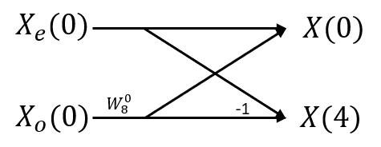
FFT Algorithm – Butterfly diagram
11

Slide 11
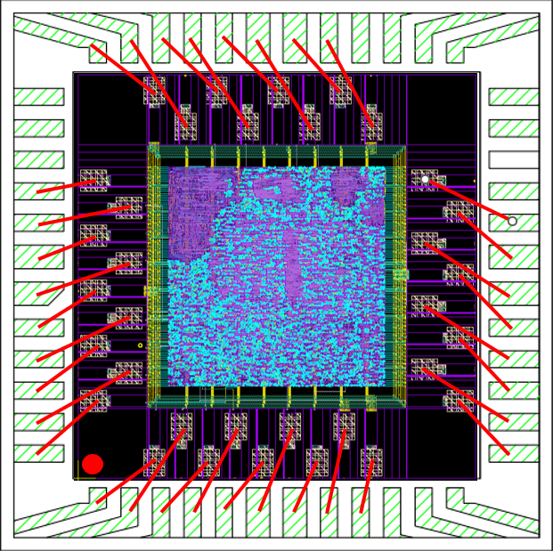
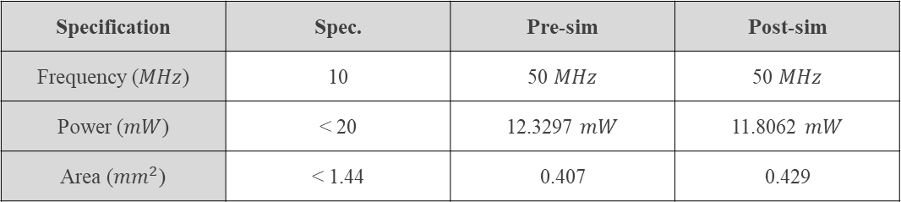
FFT-結果
Specification | Spec. | Pre-sim | Post-sim
Frequency ($MHz$) | 10 | 50 $MHz$ | 50 $MHz$
Power ($mW$) | < 20 | 12.3297 $mW$ | 11.8062 $mW$
Area (${mm}^{2}$) | < 1.44 | 0.407 | 0.429
12

Slide 12






教育性晶片下線經驗-AES
Symmetric encryption
Mathematical operations are relatively less complicated, lower hardware costs, and faster speed.
key
transmission
sender
plaintext
Encrypt
ciphertext
ciphertext
Decrypt
plaintext
recipient
13

Slide 13

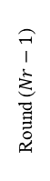
AES Algorithm
Plaintext
Key
Key Expansion
AddRoundKey
W[0, 3]
Round 1
SubBytes
AES-128
Key size | 128 bits
Plaintext block size | 128 bits
Number of rounds | 10
Round key size | 128 bits
Number of expanded keys | 44
ShiftRows
MisColumns
AddRoundKey
W[4, 7]
…
Round ($Nr−1$)
SubBytes
ShiftRows
Two important parts：
Key expansion
Message encryption
MisColumns
AddRoundKey
W[4(Nr-1), 4(Nr-1)+3]
Round $N$r
SubBytes
ShiftRows
AddRoundKey
W[4Nr, 4Nr+3]
Ciphertext
14

Slide 14
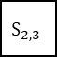
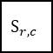
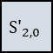
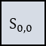
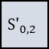
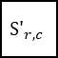
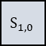

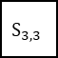
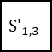
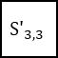

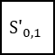
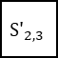
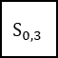
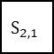
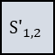
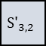
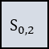
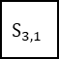
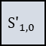
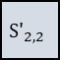
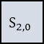
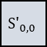
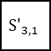
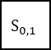
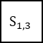
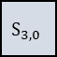
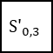
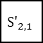
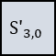
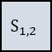
AES Algorithm – Substitute Bytes
S-box |  | Column
 |  | 0 | 1 | 2 | 3 | 4 | 5 | 6 | 7 | 8 | 9 | a | b | c | d | e | f
Row | 0 | 63 | 7c | 77 | 7b | f2 | 6b | 6f | c5 | 30 | 01 | 67 | 2b | fe | d7 | ab | 76
 | 1 | ca | 82 | c9 | 7d | fa | 59 | 47 | f0 | ad | d4 | a2 | af | 9c | a4 | 72 | c0
 | 2 | b7 | fd | 93 | 26 | 36 | 3f | f7 | cc | 34 | a5 | e5 | f1 | 71 | d8 | 31 | 15
 | 3 | 04 | c7 | 23 | c3 | 18 | 96 | 05 | 9a | 07 | 12 | 80 | e2 | eb | 27 | b2 | 75
 | 4 | 09 | 83 | 2c | 1a | 1b | 6e | 5a | a0 | 52 | 3b | d6 | b3 | 29 | e3 | 2f | 84
 | 5 | 53 | d1 | 00 | ed | 20 | fc | b1 | 5b | 6a | cb | be | 39 | 4a | 4c | 58 | cf
 | 6 | d0 | ef | aa | fb | 43 | 4d | 33 | 85 | 45 | f9 | 02 | 7f | 50 | 3c | 9f | a8
 | 7 | 51 | a3 | 40 | 8f | 92 | 9d | 38 | f5 | bc | b6 | da | 21 | 10 | ff | f3 | d2
 | 8 | cd | 0c | 13 | ec | 5f | 97 | 44 | 17 | c4 | a7 | 7e | 3d | 64 | 5d | 19 | 73
 | 9 | 60 | 81 | 4f | dc | 22 | 2a | 90 | 88 | 46 | ee | b8 | 14 | de | 5e | 0b | db
 | a | e0 | 32 | 3a | 0a | 49 | 06 | 24 | 5c | c2 | d3 | ac | 62 | 91 | 95 | e4 | 79
 | b | e7 | c8 | 37 | 6d | 8d | d5 | 4e | a9 | 6c | 56 | f4 | ea | 65 | 7a | ae | 08
 | c | ba | 78 | 25 | 2e | 1c | a6 | b4 | c6 | e8 | dd | 74 | 1f | 4b | bd | 8b | 8a
 | d | 70 | 3e | b5 | 66 | 48 | 03 | f6 | 0e | 61 | 35 | 57 | b9 | 86 | c1 | 1d | 9e
 | e | e1 | f8 | 98 | 11 | 69 | d9 | 8e | 94 | 9b | 1e | 87 | e7 | ce | 55 | 28 | df
 | f | 8c | a1 | 89 | 0d | bf | e6 | 42 | 68 | 41 | 99 | 2d | 0f | b0 | 54 | bb | 16
$$S_{0,0}$$
$$S_{0,1}$$
$$S_{0,2}$$
$$S_{0,3}$$
S-Box
$${S′}_{0,0}$$
$${S′}_{0,1}$$
$${S′}_{0,2}$$
$${S′}_{0,3}$$
$$S_{1,0}$$
$$S_{r,c}$$
$$S_{1,2}$$
$$S_{1,3}$$
$${S′}_{1,0}$$
$${S′}_{r,c}$$
$${S′}_{1,2}$$
$${S′}_{1,3}$$
$$S_{2,0}$$
$$S_{2,1}$$
$$S_{2,2}$$
$$S_{2,3}$$
$${S′}_{2,0}$$
$${S′}_{2,1}$$
$${S′}_{2,2}$$
$${S′}_{2,3}$$
$$S_{3,0}$$
$$S_{3,1}$$
$$S_{3,2}$$
$$S_{3,3}$$
$${S′}_{3,0}$$
$${S′}_{3,1}$$
$${S′}_{3,2}$$
$${S′}_{3,3}$$
Y
S_{(r , c)}
S-box
b7 | b6 | b5 | b4 | b3 | b2 | b1 | b0
X
X
Y
15

Slide 15
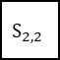
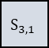
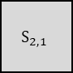
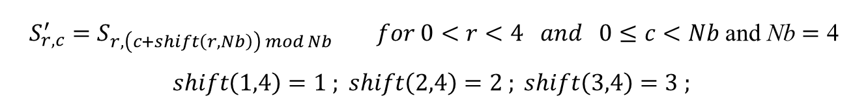
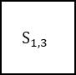

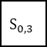



















AES Algorithm – Shift Rows
$$S_{r,c}^{′}=S_{r,\left(c+shift\left(r,Nb\right)\right) mod Nb} for 0<r<4 and 0≤c<Nb \text{and} \text{Nb}=\text{4}$$
$$shift\left(1,4\right)=1 ; shift\left(2,4\right)=2 ; shift\left(3,4\right)=3 ;$$
ShiftRows ()
$$S_{0,0}$$
$$S_{0,1}$$
$$S_{0,2}$$
$$S_{0,3}$$
$$S_{0,0}$$
$$S_{0,1}$$
$$S_{0,2}$$
$$S_{0,3}$$
$$S_{1,0}$$
$$S_{1,1}$$
$$S_{1,2}$$
$$S_{1,3}$$
$$S_{1,1}$$
$$S_{1,2}$$
$$S_{1,3}$$
$$S_{1,0}$$
$$S_{2,0}$$
$$S_{2,1}$$
$$S_{2,2}$$
$$S_{2,3}$$
$$S_{2,2}$$
$$S_{2,3}$$
$$S_{2,0}$$
$$S_{2,1}$$
$$S_{3,0}$$
$$S_{3,1}$$
$$S_{3,2}$$
$$S_{3,3}$$
$$S_{3,3}$$
$$S_{3,0}$$
$$S_{3,1}$$
$$S_{3,2}$$
16

Slide 16

































AES Algorithm – Mix Columns
$$a\left(x\right)=\left\{03\right\}x^{3}+\left\{01\right\}x^{2}+\left\{01\right\}x+\left\{02\right\}$$
$$S′\left(x\right)=a\left(x\right) ⨂ S\left(x\right)$$
$$\left[\begin{aligned}{S′}_{0,c} \\ {S′}_{1,c} \\ {S′}_{2,c} \\ {S′}_{3,c}\end{aligned}\right]=\left[\begin{aligned}02 \\ 01 \\ 01 \\ 03\end{aligned} \begin{aligned}03 \\ 02 \\ 01 \\ 01\end{aligned} \begin{aligned}01 \\ 03 \\ 02 \\ 01\end{aligned} \begin{aligned}01 \\ 01 \\ 03 \\ 02\end{aligned}\right]\left[\begin{aligned}S_{0,c} \\ S_{1,c} \\ S_{2,c} \\ S_{3,c}\end{aligned}\right] for 0≤c<Nb$$
MixColumns ()
$$S_{0,0}$$
$$S_{0,c}$$
$$S_{0,2}$$
$$S_{0,3}$$
$${S′}_{0,0}$$
$${S′}_{0,c}$$
$${S′}_{0,2}$$
$${S′}_{0,3}$$
$$S_{1,0}$$
$$S_{1,c}$$
$$S_{1,2}$$
$$S_{1,3}$$
$${S′}_{1,0}$$
$${S′}_{1,c}$$
$${S′}_{1,2}$$
$${S′}_{1,3}$$
$$S_{2,0}$$
$$S_{2,c}$$
$$S_{2,2}$$
$$S_{2,3}$$
$${S′}_{2,0}$$
$${S′}_{2,c}$$
$${S′}_{2,2}$$
$${S′}_{2,3}$$
$$S_{3,0}$$
$$S_{3,c}$$
$$S_{3,2}$$
$$S_{3,3}$$
$${S′}_{3,0}$$
$${S′}_{3,c}$$
$${S′}_{3,2}$$
$${S′}_{3,3}$$
17

Slide 17






































AES Algorithm – Add Round Keys
$$\left[{S′}_{0,c} , {S′}_{1,c} , {S′}_{2,c} , {S′}_{3,c}\right]=\left[S_{0,c} , S_{1,c} , S_{2,c} , S_{3,c}\right] ⨁ \left[W_{round∗Nb+c}\right]$$
$$for 0≤c<Nb，0≤round<Nr$$
$$i=round∗Nb$$
$$S_{0,0}$$
$$S_{0,c}$$
$$S_{0,2}$$
$$S_{0,3}$$
$$W_{i}$$
$$W_{i+c}$$
$$W_{i+2}$$
$$W_{i+3}$$
$${S′}_{0,0}$$
$${S′}_{0,c}$$
$${S′}_{0,2}$$
$${S′}_{0,3}$$
$$S_{1,0}$$
$$S_{1,c}$$
$$S_{1,2}$$
$$S_{1,3}$$
$${S′}_{1,0}$$
$${S′}_{1,c}$$
$${S′}_{1,2}$$
$${S′}_{1,3}$$
$$S_{2,0}$$
$$S_{2,c}$$
$$S_{2,2}$$
$$S_{2,3}$$
$${S′}_{2,0}$$
$${S′}_{2,c}$$
$${S′}_{2,2}$$
$${S′}_{2,3}$$
$$S_{3,0}$$
$$S_{3,c}$$
$$S_{3,2}$$
$$S_{3,3}$$
$${S′}_{3,0}$$
$${S′}_{3,c}$$
$${S′}_{3,2}$$
$${S′}_{3,3}$$
18

Slide 18


AES Algorithm – Key Expansion
$$\left\{ \begin{aligned}&Rcon\left[i\right]=\left\{temp\left[i\right], 0, 0, 0\right\} \\ &temp\left[i\right]=2 ⋅ temp\left[i − 1\right] for 1≤i≤Nr \\ &temp\left[1\right]=1\end{aligned}\right.$$
19

Slide 19

AES Module
20

Slide 20



AES DC Result
20

Slide 21




AES DC Result
Power
Specification | Spec. | Pre-sim
Frequency ($MHz$) | 100$MHz$ | 100 $MHz$
Power ($mW$) | 20 | 2.5726 $mW$
Area (${mm}^{2}$) | < 1.44 | 0.1849
Area
Timing
20

Slide 22
03
系統晶片設計實驗
Notes:
在碩一上的時候去台大修了這堂課，這堂主要是在教我們三個重點，第一個是如何在FPGA和ASIC上使用Verilog與HLS設計且實現專案，第二個是將專案整合到Caravel SOC上，第三個是利用Caravel FPGA去做實際模擬。

Slide 23

Block Diagram
22
Notes:
我首先介紹一下在這堂課最主要用到的Caravel SOC的bloack diagram，在Management這塊當中是SOC的核心所在，因為CPU是放在這邊，本CPU是採用ex-RSIC V架構，圍繞整體架構的Wishbone bus，透過11個clk去響應並排程各個不同的輸出入訊號，而我們在做硬體加速的專案與RAM都是放在USER project這邊，再來是MPRJ，這38根腳位是系統主要與外界溝通的管道，他的輸出入與功能設定可由Management或User project亦或者testbemch去設置，

Slide 24
Function
An accelerator for finite impulse response(11), matrix multiplication (4 x 4), and quicksort (11) has been designed and integrated into the SoC.
The baud rate for the UART has been changed from 9600 to 115200.
The type of memory is BRAM with prefetch controller.
The designs have be implemented on SoC.
The SoC have be programed into FPGA and verified on jupyter notebook
23

Slide 25


Block Diagram
24
Notes:
這是我們在這堂課當中Final project的block diagram，我們實現了FIR、QS、MM的硬體加速器，

Slide 26
Configuration Register Address Map
User Project | Base Address Map
Memory Starting | 3800_0000
FIR Base Address | 3600_0000
Matrix Multiplication Base Address | 3400_0000
Quick Sort Base Address | 3200_0000
UART Base Address | 3000_0000
25

Slide 27
Configuration Register Address Map - FIR
FIR
0x00 | [0] | ap_start (r/w)
 | [1] | ap_done (ro)
 | [2] | ap_idle (ro)
 | [3] | X[n]_ready to accept input (ro)
 | [4] | Y[n] is ready to read
0x10-13 | data-length
0x40-7F | Tap parameters
0x80-83 | X[n] input (r/w)
0x84-87 | Y[n] output (ro)
26

Slide 28
Configuration Register Address Map - Matrix Multiplication
Matrix Multiplication
0x00 | [0] | ap_start (r/w)
 | [1] | ap_done (ro)
 | [2] | ap_idle (ro)
 | [3] | X[n]_ready to accept input (ro)
 | [4] | Y[n] is ready to read
0x80-83 | X[n] input (r/w)
0x84-87 | Y[n] output (ro)
27

Slide 29
Configuration Register Address Map – Quick Sort
Quick Sort
0x00 | [0] | ap_start (r/w)
 | [1] | ap_done (ro)
 | [2] | ap_idle (ro)
 | [3] | X[n]_ready to accept input (ro)
 | [4] | Y[n] is ready to read
0x80-83 | X[n] input (r/w)
0x84-87 | Y[n] output (ro)
28

Slide 30
04
其他作品

Slide 31

16-bit RISC Implementation
30

Slide 32

16-bit RISC Implementation
31

Slide 33

16-bit RISC Implementation
32

Slide 34
IC競賽
實現流程：
Python 設計演算法
Vivado 實現演算法硬體架構
Design Compiler 合成電路
VSC 驗證電路功能
Verdi 觀察波型與Debug
IC Contest 2018-2023的電路設計皆達到最高成績
Laser Treatment
Job Assignment Machine
Geofence
String Matching Engine
Image Convolutional Circuit Design
Huffman Coding
30

Slide 35
感謝聆聽
Thank you for your attention.

Slide 36

教育性晶片下線經驗-FFT
硬體規格
項目 | 時脈頻率 | 腳位數量 |  |  | 面積
 |  | 電源 | 輸入 | 輸出
規格 | 50MHz | 10 | 14 | 10 | 0.429${mm}^{2}$
軟體規格(輸入)
項目 | clock | reset | 資料選擇線 | 資料輸入
 |  |  |  | 實部 |  |  | 虛部
 |  |  |  | 符號 | 整數 | 小數 | 符號 | 整數 | 小數
Bit(s) | 1 | 1 | 4 | 1 | 15 | 8 | 1 | 15 | 8
數量 | 1 | 1 | 1 | 8 |  |  | 8
軟體規格(輸出)
項目 | Ready signal | Next signal | 資料輸出
 |  |  | 實部 |  |  | 虛部
 |  |  | 符號 | 整數 | 小數 | 符號 | 整數 | 小數
Bit(s) | 1 | 1 | 1 | 15 | 8 | 1 | 15 | 8
數量 | 1 | 1 | 8 |  |  | 8
09

Slide 37



AES Algorithm
Plaintext(128 bits)
Secret key(128 bits)
State array (4*4*8)
State array (size depends on AES type)
Initial transformation
Key
Expansion
State array (4*4*8)
1th Round key(4*4*8)
AES-128
Key size | 128 bits
Plaintext block size | 128 bits
Number of rounds | 10
Round key size | 128 bits
Number of expanded keys | 44
Round 1 to (N-1)
SubBytes
ShiftRows
MixColumns
AddRoundKey
i^{th} Round key(4*4*8)
Round N
SubBytes
ShiftRows
AddRoundKey
N^{th} Round key(4*4*8)
State array (4*4*8)
Ciphertext(128 bits)
14

Slide 38

AES DC Result
20

Slide 39











教育性晶片下線經驗-AES
Look-up Functionality
Composite Field Operation
Direct Logical Mapping
Multiplicative Inverse + Affine Transformation
4
$$x^{2}$$
$$×λ$$
$$×$$
4
8
$$δ$$
$$x^{−1}$$
8
$$δ^{−1}$$
&
affine
8
data_in
data_out
4
$$×$$
$$×$$
4
06

Slide 40





教育性晶片下線經驗-AES
Multiplicative inverse
If $a∙a^{−1}=1$, $a^{−1}$ is the multiplicative inverse of $a$.
From [11], the multiplicative inverse can be computed using Equation.
$${(bx+c)}^{−1}= b{(b^{2}λ+c(b+c))}^{−1}x+(c+b){(b^{2}λ + c(b + c))}^{−1}$$
The irreducible polynomial is $x^{2}+x+λ$.
4
$$x^{2}$$
$$×λ$$
$$×$$
4
data_in
8
$$δ$$
$$x^{−1}$$
8
$$δ^{−1}$$
8
data_out
4
$$×$$
$$×$$
4
06
Source : E. NC Mui, “Practical Implementation of Rijndael S-Box Using Combinational Logic,” unpublished draft.

Slide 41


教育性晶片下線經驗-AES
Affine transformation
$b_{i}^{′}=b_{i}⊕b_{\left(i+4\right)mod8}⊕b_{\left(i+5\right)mod8}⊕b_{\left(i+6\right)mod8}⊕b_{\left(i+7\right)mod8}⊕c_{i}$ $for 0≤i<8$
$$c_{i}={\{63\}}_{16}={\{01100011\}}_{2}$$
$$\left[\begin{matrix}b_{0}^{′} \\ b_{1}^{′} \\ b_{2}^{′} \\ b_{3}^{′} \\ b_{4}^{′} \\ b_{5}^{′} \\ b_{6}^{′} \\ b_{7}^{′}\end{matrix}\right]=\left[\begin{matrix}1 & 0 & 0 & 0 & 1 & 1 & 1 & 1 \\ 1 & 1 & 0 & 0 & 0 & 1 & 1 & 1 \\ 1 & 1 & 1 & 0 & 0 & 0 & 1 & 1 \\ 1 & 1 & 1 & 1 & 0 & 0 & 0 & 1 \\ 1 & 1 & 1 & 1 & 1 & 0 & 0 & 0 \\ 0 & 1 & 1 & 1 & 1 & 1 & 0 & 0 \\ 0 & 0 & 1 & 1 & 1 & 1 & 1 & 0 \\ 0 & 0 & 0 & 1 & 1 & 1 & 1 & 1\end{matrix}\right]\left[\begin{matrix}b_{0} \\ b_{1} \\ b_{2} \\ b_{3} \\ b_{4} \\ b_{5} \\ b_{6} \\ b_{7}\end{matrix}\right]+\left[\begin{matrix}1 \\ 1 \\ 0 \\ 0 \\ 0 \\ 1 \\ 1 \\ 0\end{matrix}\right]$$
06

